Slide 1
Changes since Last Iteration
Bottom plate
Linear Seal

Slide 2
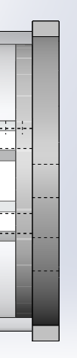
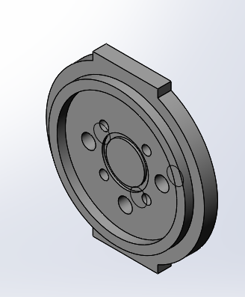
Bottom Plate
The bottom plate was modified in two ways:
The holes for the BR penetrators were added
A raised structure was added to mimic the sealing done to the electronics enclosure

Slide 3
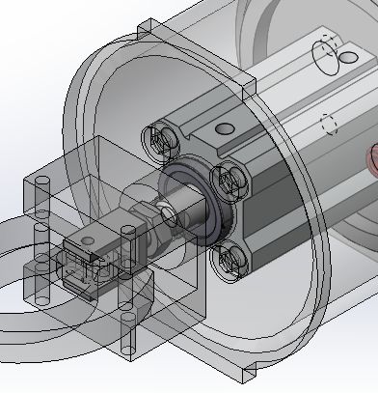
Trelleborg Linear Shaft Seal
Seal used is a model available from the Trelleborg website and is used for 10mm shafts.
As far as I can tell they are designed to be press fit into the part

Slide 4
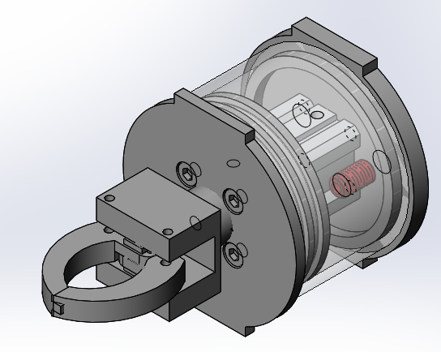
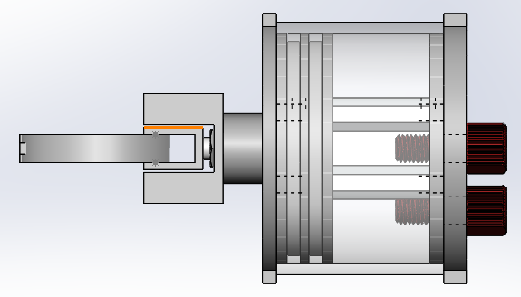
Gripper with O-Ring
Max Diameter: 96mm (3.8 in)
Max Length: 172.75mm (6.8 in)
***Need to edit geometry to allow for pneumatic fittings to sit in first position***

Slide 5
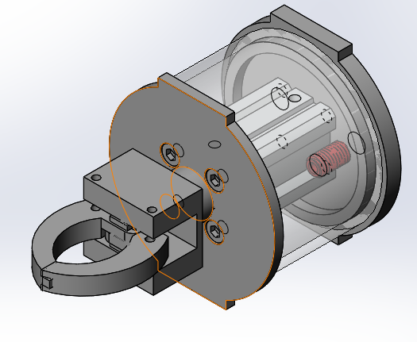
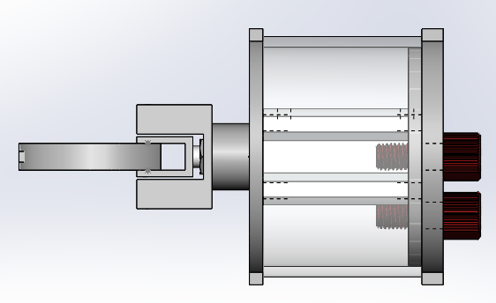
Gripper with Face Seal
Max Diameter: 96mm (3.8 in)
Max Length: 172.75mm (6.8 in)

Slide 6
What’s next?
Which type of seal is best for NUGV?
Face Seal vs O-ring seal vs something else(?)
Editing the finger geometry
Remove planned bearing slot
Complete sourcing of parts if design chosen

